Slide 1
CISE-301: Numerical Methods Topic 1: Introduction to Numerical Methods and Taylor Series Lectures 1-4:
KFUPM

Slide 2
Lecture 1 Introduction to Numerical Methods
What are NUMERICAL METHODS?
Why do we need them?
Topics covered in CISE301.
Reading Assignment: Pages 3-10 of textbook

Slide 3
Numerical Methods
Numerical Methods:
Algorithms that are used to obtain numerical solutions of a mathematical problem.
Why do we need them?
1. No analytical solution exists,
2. An analytical solution is difficult to obtain
or not practical.

Slide 4
What do we need?
Basic Needs in the Numerical Methods:
Practical:
Can be computed in a reasonable amount of time.
Accurate:
Good approximate to the true value,
Information about the approximation error (Bounds, error order,… ).

Slide 5
Outlines of the Course
Taylor Theorem
Number Representation
Solution of nonlinear Equations
Interpolation
Numerical Differentiation
Numerical Integration
Solution of linear Equations
Least Squares curve fitting
Solution of ordinary differential equations
Solution of Partial differential equations

Slide 6
Solution of Nonlinear Equations
Some simple equations can be solved analytically:
Many other equations have no analytical solution:

Slide 7
Methods for Solving Nonlinear Equations
Bisection Method
Newton-Raphson Method
Secant Method

Slide 8
Solution of Systems of Linear Equations

Slide 9
Cramer’s Rule is Not Practical

Slide 10
Methods for Solving Systems of Linear Equations
Naive Gaussian Elimination
Gaussian Elimination with Scaled Partial Pivoting
Algorithm for Tri-diagonal Equations

Slide 11
Curve Fitting
Given a set of data:
Select a curve that best fits the data. One choice is to find the curve so that the sum of the square of the error is minimized.

Slide 12
Interpolation
Given a set of data:
Find a polynomial P(x) whose graph passes through all tabulated points.

Slide 13
Methods for Curve Fitting
Least Squares
Linear Regression
Nonlinear Least Squares Problems
Interpolation
Newton Polynomial Interpolation
Lagrange Interpolation

Slide 14
Integration
Some functions can be integrated analytically:

Slide 15
Methods for Numerical Integration
Upper and Lower Sums
Trapezoid Method
Romberg Method
Gauss Quadrature

Slide 16
Solution of Ordinary Differential Equations

Slide 17
Solution of Partial Differential Equations
Partial Differential Equations are more difficult to solve than ordinary differential equations:

Slide 18
Summary
Numerical Methods:
Algorithms that are used to obtain numerical solution of a mathematical problem.
We need them when
No analytical solution exists or it is difficult to obtain it.
Topics Covered in the Course
Solution of Nonlinear Equations
Solution of Linear Equations
Curve Fitting
Least Squares
Interpolation
Numerical Integration
Numerical Differentiation
Solution of Ordinary Differential Equations
Solution of Partial Differential Equations

Slide 19
Lecture 2 Number Representation and Accuracy
Number Representation
Normalized Floating Point Representation
Significant Digits
Accuracy and Precision
Rounding and Chopping
Reading Assignment: Chapter 3

Slide 20
Representing Real Numbers
You are familiar with the decimal system:
Decimal System: Base = 10 , Digits (0,1,…,9)
Standard Representations:

Slide 21
Normalized Floating Point Representation
Normalized Floating Point Representation:
No integral part,
Advantage: Efficient in representing very small or very large numbers.

Slide 22
Calculator Example
Suppose you want to compute:
3.578 * 2.139
using a calculator with two-digit fractions
3.57
*
2.13
=
7.60
True answer:
7.653342

Slide 23
Binary System
Binary System: Base = 2, Digits {0,1}

Slide 24
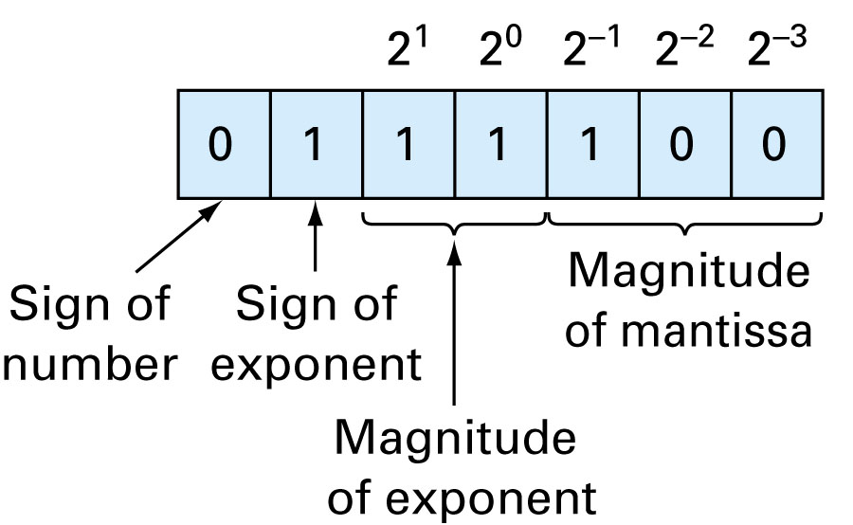
7-Bit Representation (sign: 1 bit, mantissa: 3bits, exponent: 3 bits)

Slide 25
Fact
Numbers that have a finite expansion in one numbering system may have an infinite expansion in another numbering system:
You can never represent 0.1 exactly in any computer.

Slide 26
Representation
Hypothetical Machine (real computers use ≥ 23 bit mantissa)
Mantissa: 3 bits Exponent: 2 bits Sign: 1 bit
Possible positive machine numbers:
.25 .3125 .375 .4375 .5 .625 .75 .875
1 1.25 1.5 1.75
Notes:
Exponent: 2 bits; 1 for sign of exponent, and 1 for magnitude of exponent.

Slide 27
Representation
Gap near zero

Slide 28
Remarks
Numbers that can be exactly represented are called machine numbers.
Difference between machine numbers is not uniform
Sum of machine numbers is not necessarily a machine number:
0.25 + .3125 = 0.5625 (not a machine number)

Slide 29
Significant Digits
Significant digits are those digits that can be used with confidence.

Slide 30
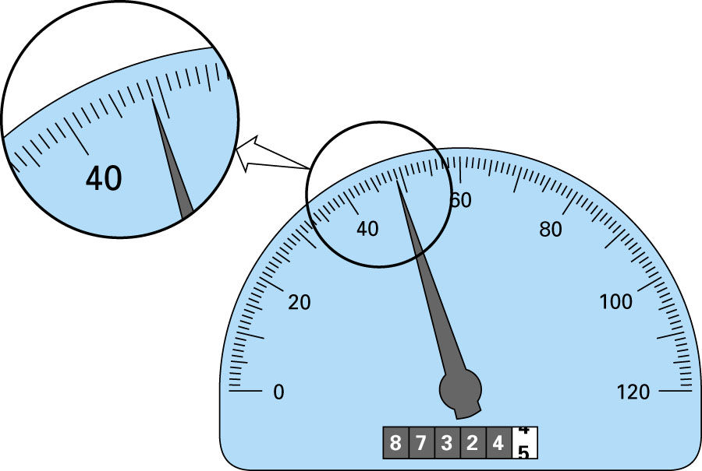
48.9
Significant Digits - Example

Slide 31
Accuracy and Precision
Accuracy is related to the closeness to the true value.
Precision is related to the closeness to other estimated values.
The degree of precision in a measurement is shown by using significant digits.

Slide 32
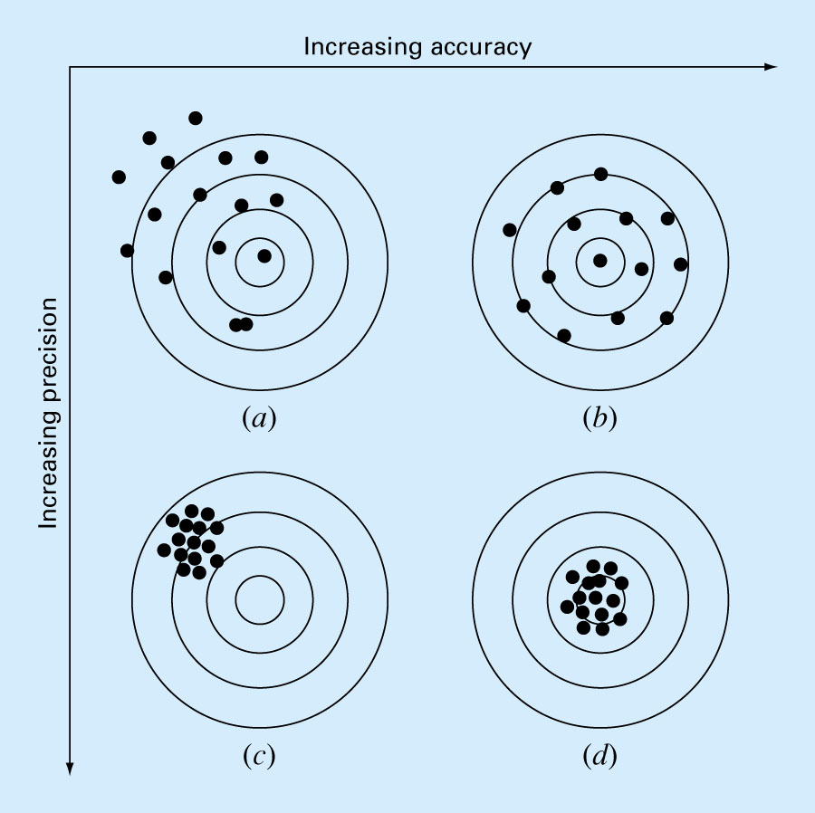

Slide 33
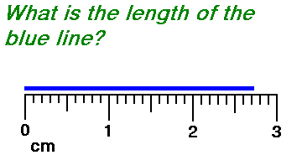
How Many Significant Digits?
By convention, a measurement is recorded by writing all exactly known numbers and 1 number which is uncertain, together with a unit label.
Example:
Blue line is 2.73 cm long. This measurement has 3 significant digits.
First 2 digits (2.7 cm) are exactly known
Third digit (0.03 cm) is uncertain because it was estimated 1 digit beyond the smallest graduation.

Slide 34
How Many Significant Digits? (Contd.)
Rule: all non-zero digits are significant
Rule: zeros between non-zero digits are significant
Example: 205 m ⇒ 3 SD
Rule: zeros to the left of the first non-zero digit are NOT significant
Example: 0.00345 s ⇒ 3 SD
Example: 2.00345 s ⇒ 6 SD

Slide 35
How Many Significant Digits? (Contd.)
Rule: if a number has a decimal point, then trailing zeros are significant
Example: 0.275000 m ⇒ 6 SD
Example: 267.000 m ⇒ 6 SD
Rule: if a number has NO decimal point, then trailing zeros are NOT significant
Example: 275 000 m ⇒ 3 SD
Example: 275 000. m ⇒ 6 SD

Slide 36
How Many Significant Digits? (Contd.)
Rule: for addition and subtraction, the answer has the same precision as the measurement with the LEAST precision
Example: 375.4 m + 2.54 m = ? ⇒ 377.9 m
Rule: for multiplication and division, the answer has the same number of significant figures as the measurement with the FEWEST significant digits
Example: (20.0 m)(3.0 m) = ?
⇒ 60. m or 6.0 x 10¹ m

Slide 37
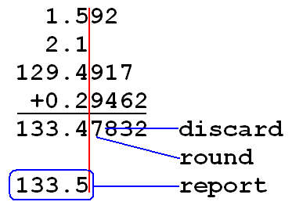
SDs – Addition and Subtraction
When adding or subtracting do NOT extend the result beyond the first column with a doubtful figure. For example, …

Slide 38
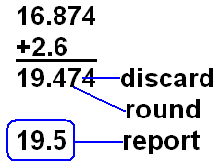
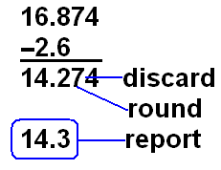
SDs – Addition and Subtraction
What is 16.874 + 2.6?
What is 16.874 - 2.6?

Slide 39
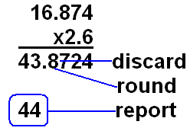
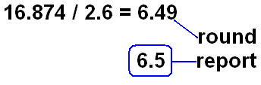
SDs – Multiplication and Division
When multiplying or dividing the answer will have the same number of significant digits as the least accurate number used to get the answer. For example, …
2.005 g / 4.95 mL = 0.405 g/mL
What is 16.874 x 2.6?
What is 16.874 / 2.6?

Slide 40
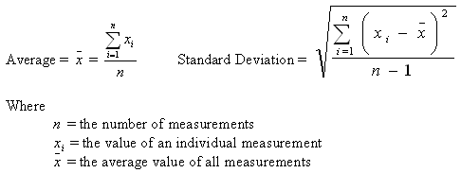
SDs and Calculations that Require Multiple Steps
An average is the best estimate of the true value of a parameter.
A standard deviation is a measure of precision.
Averages and standard deviations require several steps to calculate. You must keep track of the number of significant figures during each step. Do NOT discard or round any figures until the final number is reported.

Slide 41
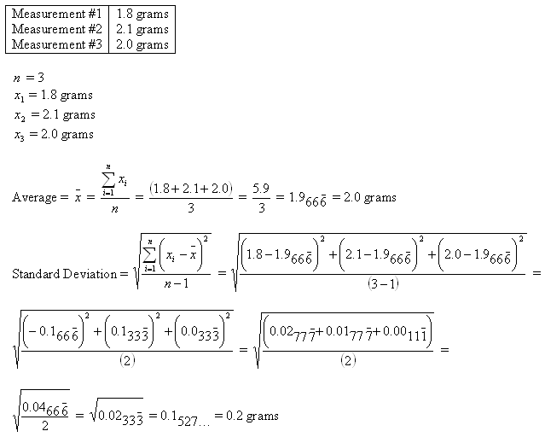
SDs and Calculations that Require Multiple Steps
2 Significant Figures
∞
Significant Figures
2 Significant Figures
1 Significant Figure
1 Significant Figure
1 Significant Figure
0 Significant Figures

Slide 42
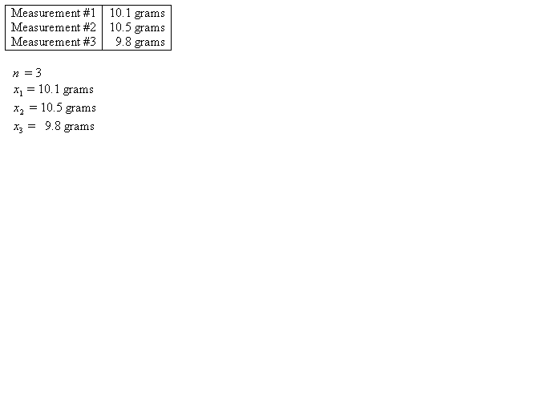

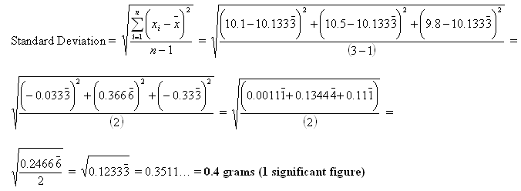
What is average and standard deviation for the following 3 measurements of the same sample?

Slide 43
Rounding and Chopping
Rounding: Replace the number by the nearest
machine number.
Chopping: Throw all extra digits.

Slide 44
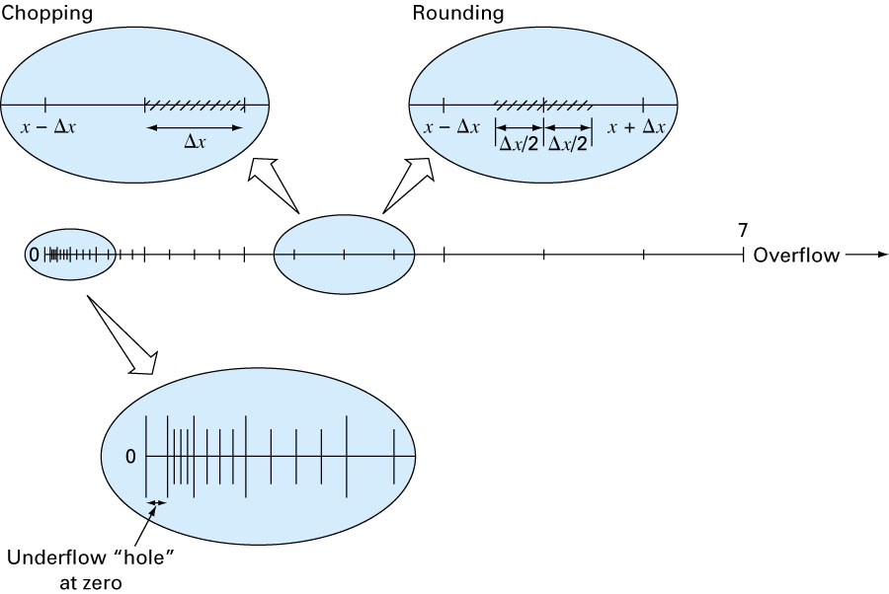
Rounding and Chopping - Example

Slide 45
Error Definitions – True Error
Can be computed if the true value is known:

Slide 46
Error Definitions – Estimated Error
When the true value is not known:

Slide 47
Notation
We say that the estimate is correct to n decimal digits if:
We say that the estimate is correct to n decimal digits rounded if:

Slide 48
Summary
Number Representation
Numbers that have a finite expansion in one numbering system may have an infinite expansion in another numbering system.
Normalized Floating Point Representation
Efficient in representing very small or very large numbers,
Difference between machine numbers is not uniform,
Representation error depends on the number of bits used in the mantissa.

Slide 49
Lectures 3-4 Taylor Theorem
Motivation
Taylor Theorem
Examples
Reading assignment: Chapter 4

Slide 50
Motivation
We can easily compute expressions like:
Taylor series is used to express function in an approximate fashion
b
a
0.6

Slide 51
Taylor Series
Taylor series predicts func. value at one point x in terms of the func. value & its derivatives at another point x₀.
1st-order approx.
zero-order approx.

Slide 52
Taylor Series – Example 1

Slide 53
Taylor Series Example 1

Slide 54
Taylor Series – Example 2

Slide 56
Convergence of Taylor Series (Observations, Example 1)
The Taylor series converges fast (few terms are needed) when x is near the point of expansion. If |x-c| is large then more terms are needed to get a good approximation.

Slide 57
Taylor Series – Example 3

Slide 58
Example 3 – Remarks
Can we apply Taylor series for x>1??
How many terms are needed to get a good approximation???
These questions will be answered using Taylor’s Theorem.

Slide 59
Taylor’s Theorem
(n+1) terms Truncated Taylor Series
Remainder
( or approx. error)

Slide 60
Taylor’s Theorem

Slide 61
Error Term

Slide 62
Error Term – Example 4

Slide 63
Alternative form of Taylor’s Theorem

Slide 64
Taylor’s Theorem – Alternative forms

Slide 65
Mean Value Theorem

Slide 66
Alternating Series Theorem

Slide 67
Alternating Series – Example 5

Slide 68
Example 6

Slide 69
Example 6 – Taylor Series

Slide 70
Example 6 – Error Term

Slide 71
Remark
In this course, all angles are assumed to be in radian unless you are told otherwise.

Slide 72
Maclaurin Series
Find Maclaurin series expansion of cos (x).
Maclaurin series is a special case of Taylor series with the center of expansion c = 0.

Slide 73
Maclaurin Series – Example 7

